Slide 1

Binary Rewriting by Using Dyninst
1/14/2021

Slide 2
Contents
Dyninst
Mutator & Mutatee
Scripts

Slide 3
Dyninst
Dyninst is a binary instrumentation tool.
Dyninst contains many useful APIs:
Dyninst API
Patch API
Parse API
Generally, Dyninst can be used to instrument a function and memory access, or instrument the code coverage.
In this implementation, after getting the execution path from symbolic execution, we will use Dyninst to rewrite a binary file.

Slide 4
Mutator & Mutatee
Mutator is written by user, which uses the API library to operate on the application.
Mutatee is the binary object we would like to instrument.
For CustomPro project:
Mutator: rewrite.cpp
Mutatee: openssl

Slide 5
Scripts
We provided sample scripts to demonstrate how to use Dyninst for binary rewriting.
Goal: Rewrite the specific basic block with nops (0x90).
Programming language: C++
System: Ubuntu 16.04 32bit
We shall build the appropriate environment for Dyninst.
Refer to URL: https://github.com/dyninst/dyninst.
Base on the property of binary we would like to instrument.

Slide 6
Scripts
Code outline:
Use bpatch.openBinary() to open original binary file.
Scan the binary and find out all the functions and basic blocks.
Locate the desired basic block with known address from symbolic execution.
Use defined function rewriteBlock() to rewrite the basic block.
Use writeFile() to write the instrumented binary into a new file.
The sample mutator rewrite.cpp and Makefile are provided.

Slide 7
Scripts
How to use scripts in terminal:
Compiling: Type $make in the directory where Makefile is located.
Running: Type $./rewrite to do the rewriting.
Checking: Type $objdump -d openssl-rewritten to check new binary.
How to modify variables in sample mutator:
Path[] (Line 38): Fill in addresses provided by symbolic execution path.
originalBinary (Line 58): Fill in name of input binary file we would like to instrument.
instrumentedBinary (Line 59): Fill in name of new output binary file.
You are encouraged to change the script for your personal usage!

Slide 8
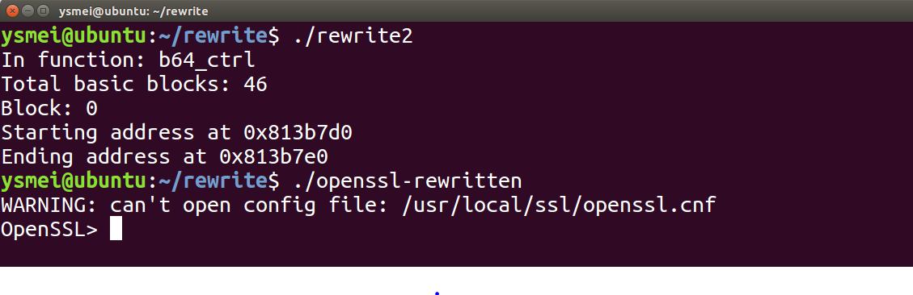
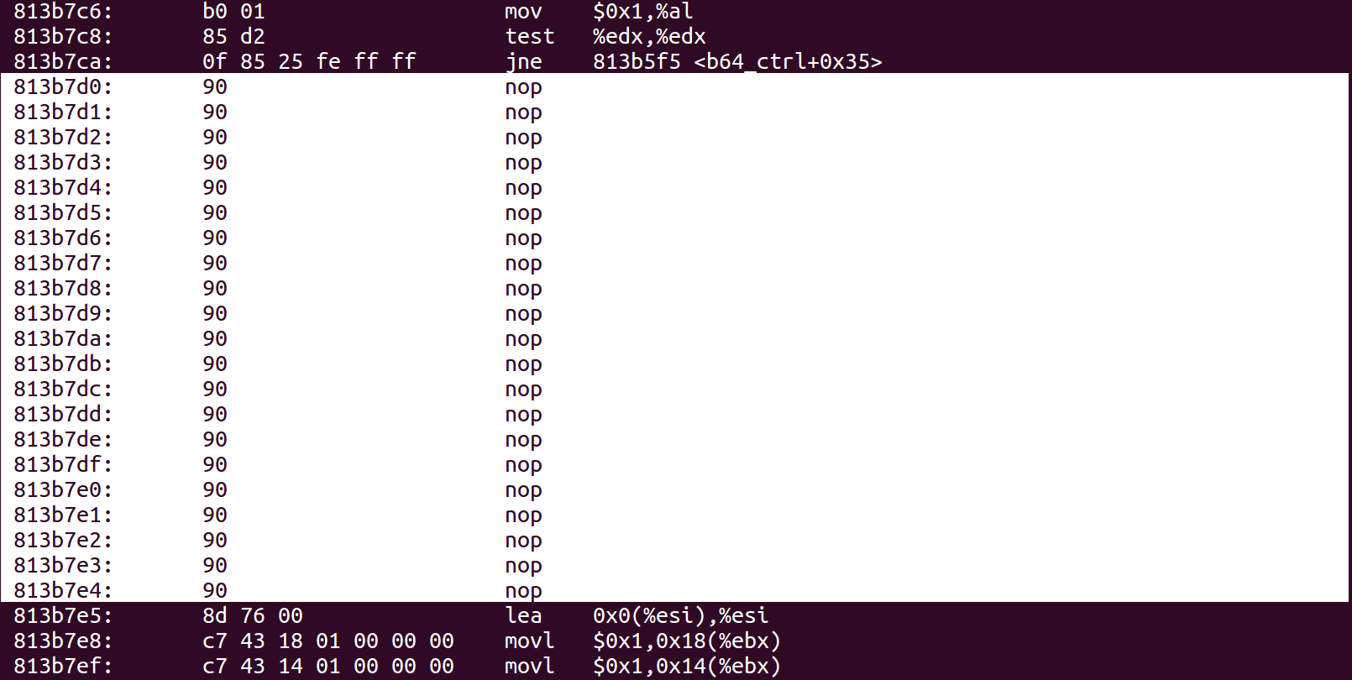
Scripts
Sample results
Mutator:
Name of mutator here is rewrite2.cpp.
Instrumented binary can be executed.
Instrumented binary:
One basic block get from symbolic execution path has been overwritten into nops.

